Slide 1

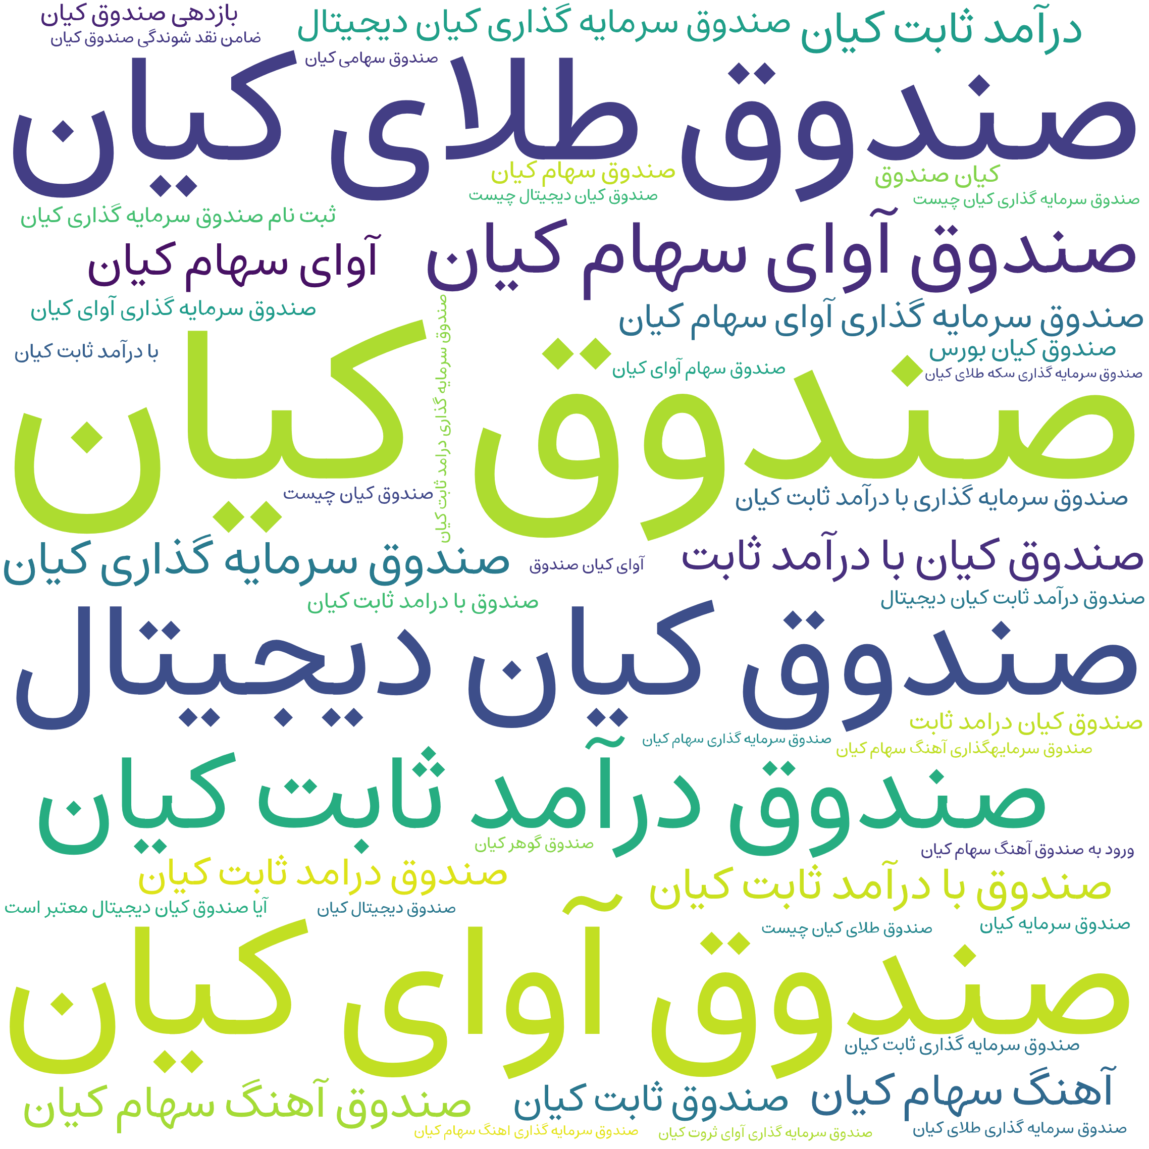
Type | Google Search | Percent
All investment funds | 125750 | 98.09%
Kian | 2450 | 1.91%

